Slide 1
Fall Update 3
Dev Bhatia
Ultrafast Optics Laboratory
Boston University

Slide 2
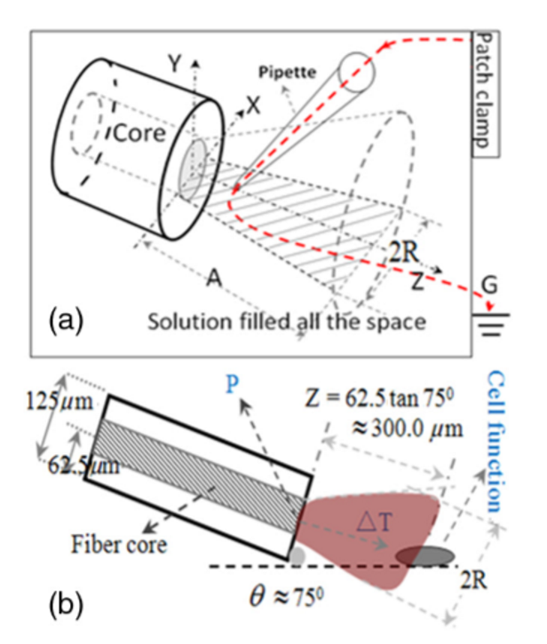
Open Pipette Method for ADTR Measurement [1]
Rapid temperature measurement technique at the micron scale
Carried out by using a microamp current amplifier
Synchronized laser irradiation would cause a local temperature change
This would induce a resistance variation in the pipette
The measured pipette resistance was calibrated as a function of the ADTR
Fig 1. Open Pipette Method & The Geometric Relationship

Slide 3
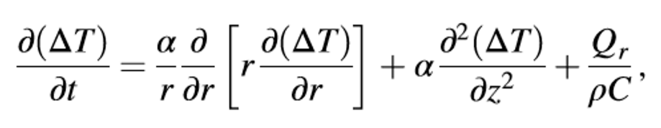
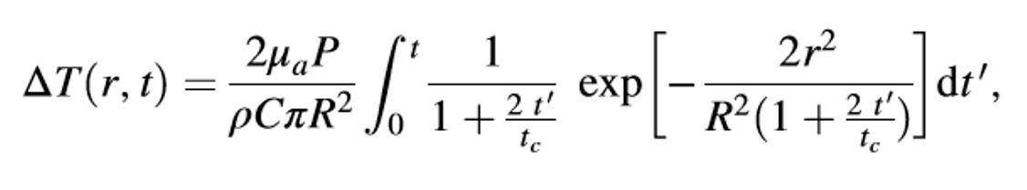
Theoretical Calculation of the ADTR [1]
Eq. 1 –
Mathematical Model of Heat Conduction Equation
Eq. 2 –
Equation 1 solved using a Gaussian approximation. ΔT obtained in consideration of the thermal lens effect
The thermal lens effect occurs when the laser beam is absorbed in the focusing region
Equation 2 predicted a linear relationship between the laser power and ΔT.
This deduction was confirmed via an open pipette method to measure the ΔT directly
980-nm wavelength infrared laser irradiation

Slide 4



Variable Considerations [1]
μa = 73.9 cm^-1 Optical Absorption Coefficient
R = 93.41 μm Beam waist at axial distance
z = 164.56 μm Axial Distance
tc = .01523 s Characteristic time of the thermal lens
P = .009999 W irradiation laser power, obeys Beer-Lambert law with the initial laser power Po
κ = 0.6 W/mK thermal conductivity
ρ = 1000 kg/m^3 density of water
c = 4188 J kg^-1 K^-1 heat capacity
r = 25 μm radius of the fiber core
ρ = resistivity determined by the open pipette
γ = conductance of pipette
T = temperature
γo = solution conductance at To
αT = temperature coefficient of solution conductance

Slide 5
Computed Values
Parameter | Calculated Value
Power at the Sample Plane | 2.9mW or 5.5mW
Beam Radius at the Sample Plane | 25.18 um
Beam Radius at the Waist | 25 um
Sample Plane Position (z-distance) | 117.55um
Characteristic Thermal Time Constant | 110.54um

Slide 6
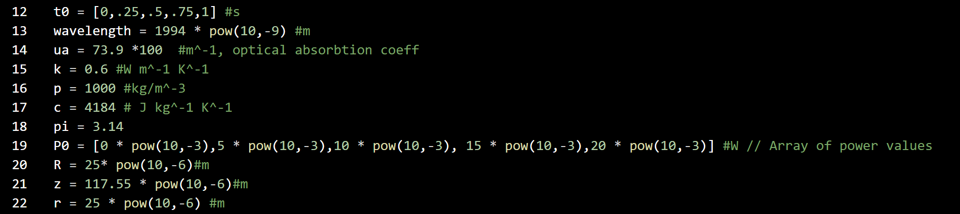
Implementation Strategy - Declarations
Fig 2.
Variable Declaration in Python
Important Considerations:
Array P0 contains initial power values
Will be turned into irradiation laser power
Laser fiber is perpendicular to the axon
Laser is perfectly columnated

Slide 7
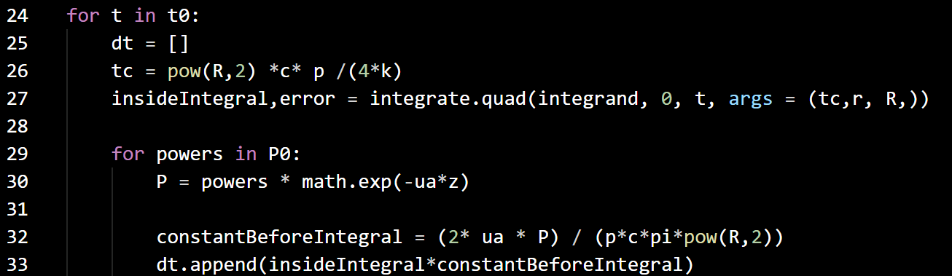
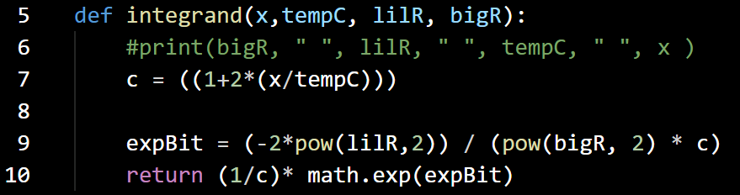

Implementation Strategy – Integration & Loop
Fig. 3 – Computation of Temperature delta with variable Power

Slide 8
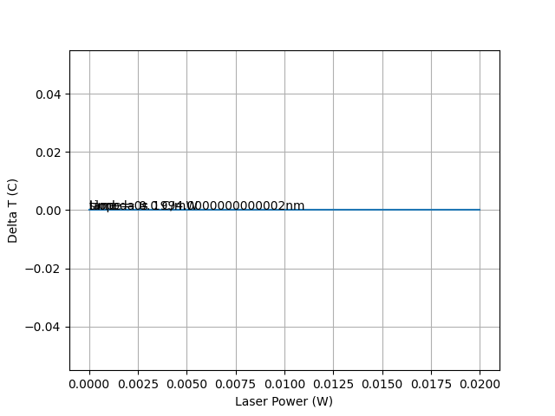
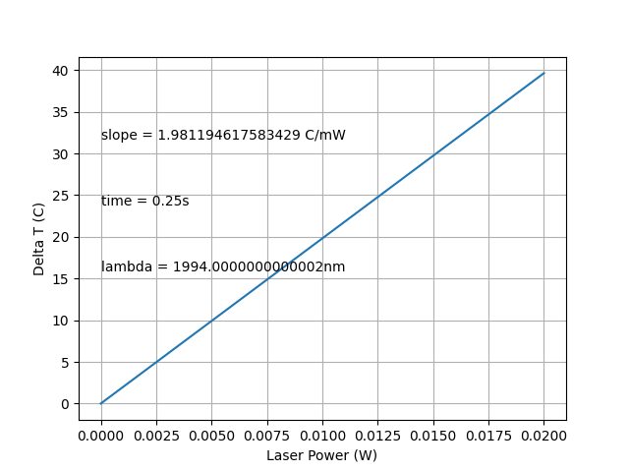
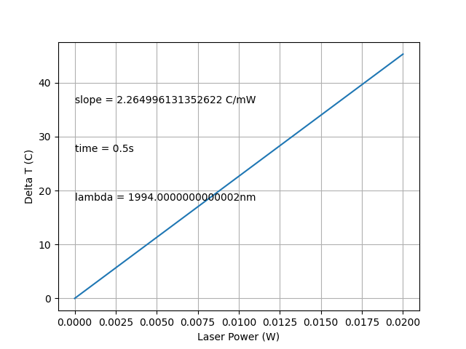
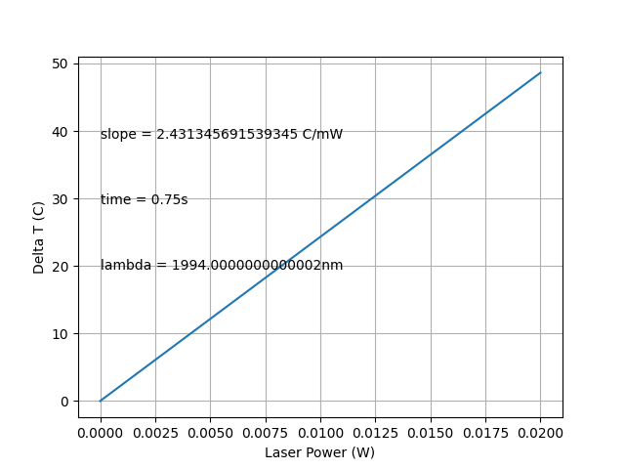
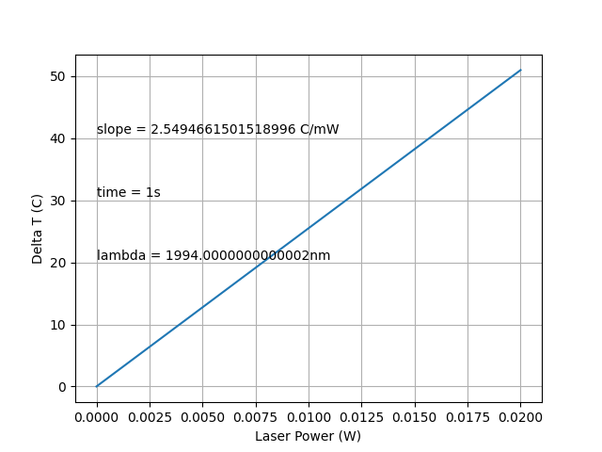
Equation Implementation Results
A
B
C
D
E
Fig. 4 – Graphical Depiction of ΔT with respect to laser power

Slide 9
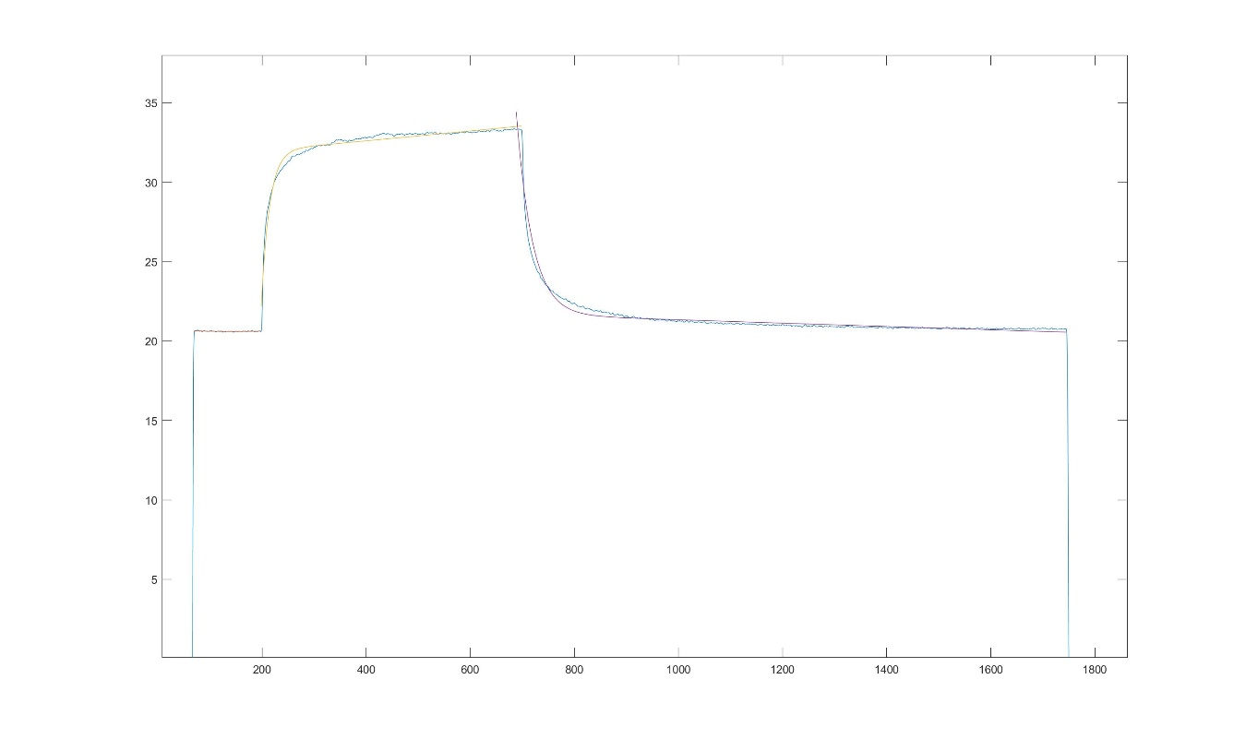
Experimental Temperature Data
Fig 5. Complete Temperature Depiction using Matlab

Slide 10
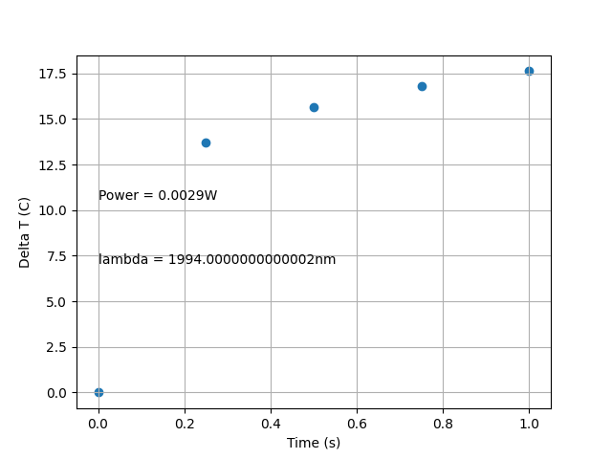
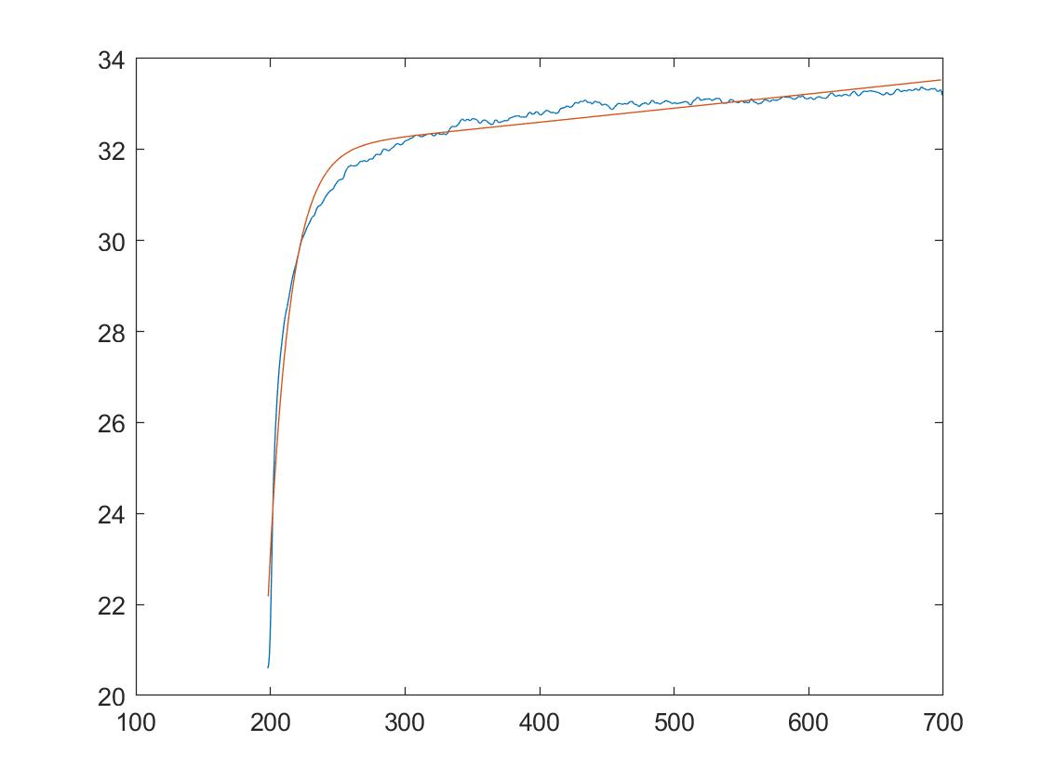
Comparison to Temperature Data
a
b
Fig. 6 – Peak temperature delta at independent times (a), experimental temperature transient (b)

Slide 11
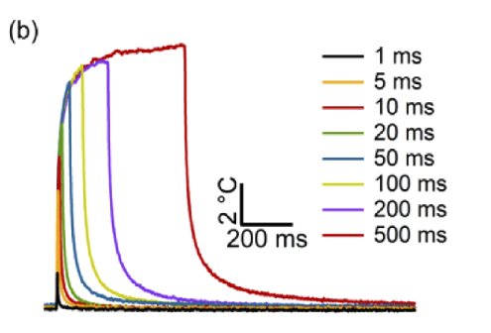
Conclusions
Shown previously is the peak temperature delta at independent times
Different metric to the experimental data – shown in Fig. 5
Slope of the lower time regimes demonstrates a slower increase in temperature
May be a symptom of the equation being used for modeling
Less Stabilization at higher regimes
Fig. 4 – Representative temperature transient

Slide 12
Next Steps
Fix the Pulse Width, explore the creation of a temperature transient
Look at early time samples, see
Find alternative model equations that lead a more accurate result
If the first bullet point is successful, this may not be needed

